Slide 1
Front End Engineering-I Project
Team Details: Harsainyam Singh(2310991840)
Harshdeep Singh(2310991841)
Harshdeep Singh(2310991842)
Faculty Coordinator: Dr.Bhisham Sharma
:
Chitkara University Institute of Engineering and Technology,
Chitkara University, Punjab

Slide 2
Table of Contents
Introduction
Problem Statement
Technical Details
Key Features
Project Highlights
Bonus Feature(optional)
Conclusion
References/Links used

Slide 3
Introduction
Welcome to our recipe website! Here, you can find and share all sorts of delicious recipes. It doesn't matter if you're a pro chef or just starting out in the kitchen – everyone is welcome. Explore a wide variety of recipes, connect with other food lovers, and enjoy the fun of cooking and sharing your favorite dishes. Get ready to discover new flavors and recipes from around the world, all in one place!
Community Engagement: Connect with fellow food enthusiasts, share your culinary creations, and exchange tips and tricks. You can leave comments, rate recipes, and even create your own virtual recipe book.
User-Friendly Interface: Our website is user-friendly and easy to navigate. Search for recipes, filter by ingredients, or explore trending dishes with just a few clicks.

Slide 4
Share Your Masterpieces: Join our community of food enthusiasts and share your own delicious creations with step-by-step instructions, photos, and cooking tips.
Recipe Categories: Browse through a diverse range of recipe categories, from comfort food classics to exotic international cuisines, ensuring there's something for every palate.

Slide 5
Problem Statement
User-Friendly Navigation:
Problem: A recipe sharing website can have numerous recipes and categories, making navigation confusing.
Solution: Create a clear and intuitive navigation menu with dropdowns or a search feature, allowing users to find recipes easily. Use CSS for styling, such as creating visually appealing buttons and navigation bars.
User Feedback and Ratings:
Problem: Users might want to provide feedback or rate recipes, which requires user interaction design.
Solution: Use CSS to style and format feedback forms, rating systems, and comments sections, making them visually appealing and easy to use.

Slide 6
Technical Details
WEB DEVELOPMENT STACK: THE TECHNOLOGY THAT WE HAVE USED IN THIS WEBSITE IS TYPICALLY HTML AND CSS FOR THE FRONT END PART.
SEARCH :WE HAVE CREATE A SEARCH FUNCTIONALITY TO HELP USERS FIND RECIPES BASED ON INGREDIANTS.
RECIPE SUBMISSION: DEVELOP A FORM FOR USER TO SUBMIT THERE RECIPES.
USER AUTHENTICATION: WE HAVE IMPLEMENT USER REGESTRATION TO ALLOW USER TO CREATE ACCOUNT,SIGN IN AND SECURILY MANAGE THERE PROFILE.
RECIPE GENERATOR: THIS METHOD HELPS USER TO GET A RECIPE FROM THE INGREDIENTS THAT USER HAVE .USER WILL ENTER THEIR INGREDIENTS TO GET A RECIPE.

Slide 7
Key Features
DELEIVERY SERVICE: WE WILL PROVIDE USER TO ADD ANY FOOD DIRECTLY TO THERE SHOPPING CARTS ON POPULAR GROCERY DELEIVERY PLATFORMS.
SEARCH BAR: WE HAVE CREATE A SEARCH FUNCTIONALITY TO HELP USERS FIND RECIPES BASED ON INGREDIANTS OR WE CALL RECIPE GENERATOR, THAT IS THEY ONLY HAVE TO WRITE NAME OF THE INGRIDENTS AND IT WILL SHOW YOU ALL POSSIBLE ITEMS MADE UP OF THESE INGRIDENTS.
RECIPE GENERATOR: THIS METHOD HELPS USER TO GET A RECIPE FROM THE INGREDIENTS THAT USER HAVE .USER WILL ENTER THEIR INGREDIENTS TO GET A RECIPE.
VIDEO RECIPES: USER CAN NOT ONLY GET WRITTEN RECIPES BUT CAN ALSO VIEW AND POST AMAZINGLY MADE VIDEO RECIPES FROM DIFFERENT PEOPLE.

Slide 8
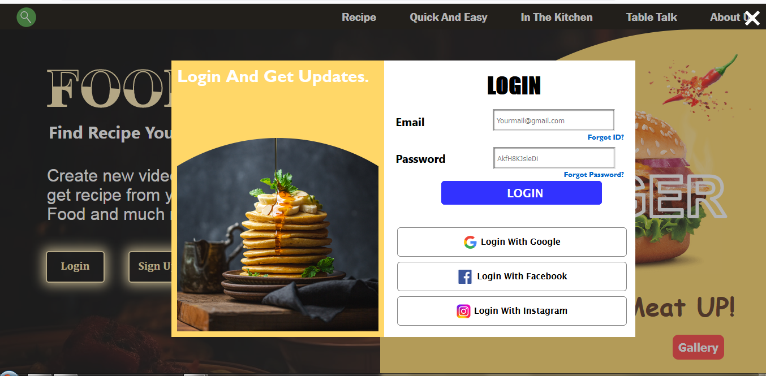
Project Highlights
LOGIN AND SIGNUP SYSTEM-:

Slide 9
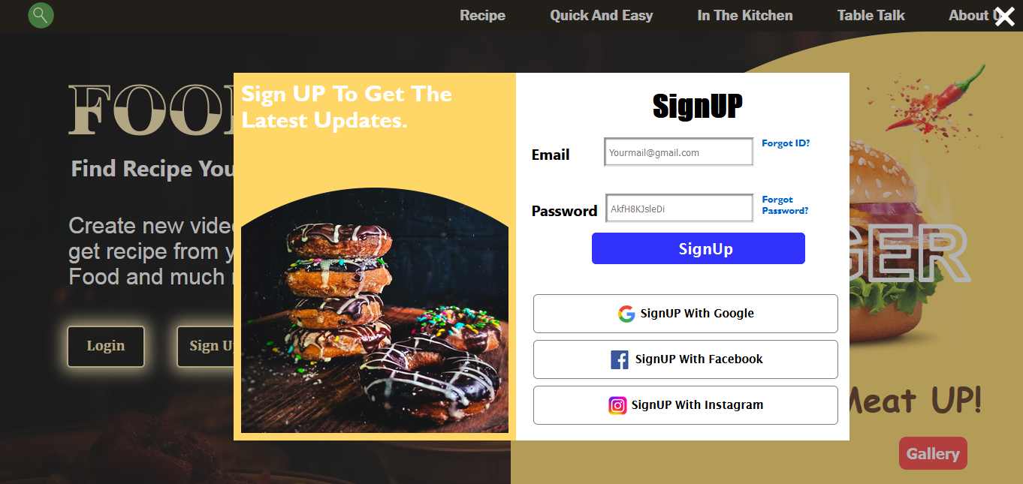

Slide 10
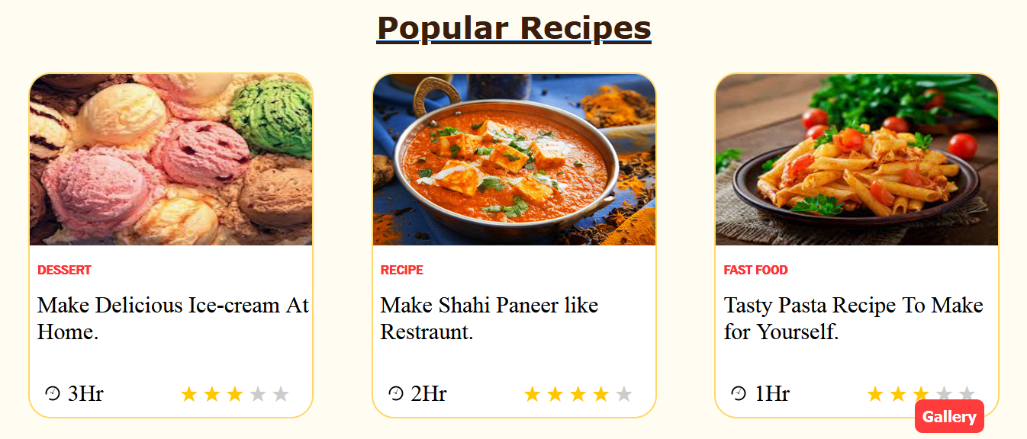
USER RATINGS :-

Slide 11

DELIVERY METHOD-:

Slide 12
Bonus Features
Add a favorite button for user to save recipes to there personal collections.
Implement a recipe rating system with stars so users can help other users to recognize a good recipe.
Include social media sharing options for user to share recipes . This will help users to easily recommend a recipe to others.

Slide 13
Conclusion
In conclusion, a recipe sharing platform website provides a valuable space for culinary enthusiasts to come together, exchange ideas, and explore the rich world of food. It fosters a sense of community, encourages creativity in the kitchen, and allows individuals to discover and share their favorite dishes with a global audience.
Our team is very thankful to be given such an amazing project . This helped us to deeply understand the vast subject of food and its related Topics . We gained a deep knowledge about Html , CSS, Javascript.

Slide 14
References/Links used
This slide should include a list of all the sources and references used in the project.

Slide 15


